Slide 1

daiquiri - Data quality reporting for temporal datasets
Phuong Quan
ORCID: 0000-0001-8566-1817
useR! 2022

Slide 2
Research practice and data quality
Initial data analysis
Typical data quality checks
Missing values
Duplicate records
Summary statistics (e.g. min/max/mean values)
Outliers
Notes:
80% of researcher time spent on preparing datasets

Slide 3
Problems with current practice
Ad-hoc and undocumented
Volume
Unknown data-generating processes
Notes:
Ad-hoc and undocumented
Data cleaning and preparation is rarely if ever mentioned in published papers
Volume
Many fields – fatigue
Data refreshed/updated – start again?
Unknown data-generating processes
Underlying systems can change over time and likely undocumented
Particularly relevant for routinely-collected data

Slide 4
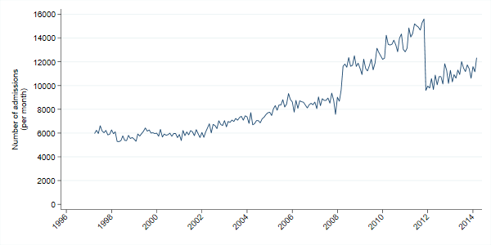
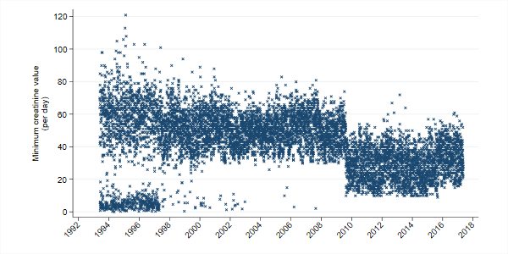
What can go wrong
Notes:
Number of inpatient admissions per month at a UK hospital.
The jump in admissions in 2008 was caused by the inclusion of dialysis day-case patients. These were then excluded again in 2012, leading to the drop in admissions.
Lowest creatinine blood test result each day.
The bimodal distribution up to 1997 was due to a mixture of units being used, and the drop in values in 2009 was due to a change in testing method and reference range

Slide 5
Works on a generic data frame
PrescriptionID | PrescriptionDate | AdmissionDate | Drug | Dose | DoseUnit | PatientID | Location
6000 | 2021-01-01 00:00:00 | 2020-12-31 | Ceftriaxone PCC | 500 | mg | 4993679 | SITE1
6001 | NULL | 2020-12-31 | Flucloxacillin | 1000 | mg | 819452 | SITE1
6002 | NULL | 2020-12-30 | Teicoplanin | 400 | mg | 275597 | SITE1
6003 | 2021-01-01 01:00:00 | 2020-12-31 | Flucloxacillin | 1000 | NULL | 819452 | SITE1
6004 | 2021-01-01 02:00:00 | 2020-12-20 | Flucloxacillin | 1000 | NULL | 528071 | SITE1
6005 | 2021-01-01 03:00:00 | 2020-12-30 | Co-amoxiclav (Penicillin Base) | 1.2 | g | 1001434 | SITE1
Notes:
What do we mean by a “temporal dataset”?
Data that contains information about something that happened at a particular date (and time)
Tabular format
One row per “event”
A column containing the date of the event
Further columns containing associated values for the event

Slide 6
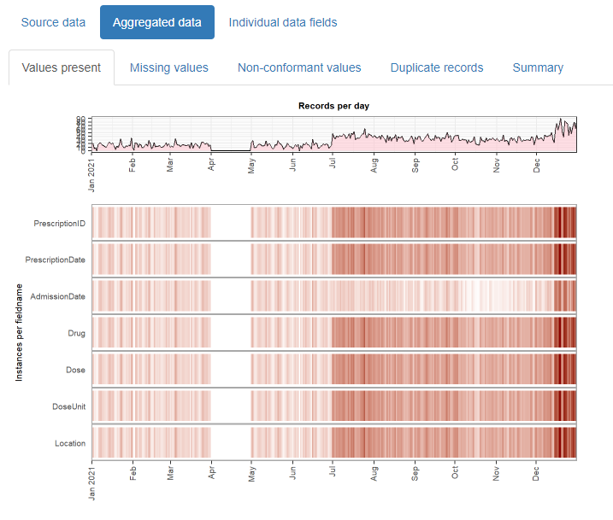
Temporal visualisations of the data

Slide 7
Live demonstration
Notes:
Speed examples:
Windows 10, 4-core i7 processor, 16GB RAM
200k rows, 25 columns, 41 MB
< 3 mins
3.6m rows, 18 columns, 619MB
<7 mins
29m rows, 13 columns, 5GB
~1 hr

Slide 8
Why use it?
Encourages good research practice
Increases transparency
Easy to use
Notes:
Encourages good research practice
Makes it easier and quicker for researchers to check for any temporal artefacts in their data
Demo’d on “raw” data but could additionally be used on a re-shaped or analysis-ready dataset
Increases transparency
Reports that can be shared and potentially uploaded as supplementary data to publications
Easy to use
R package (will be submitted to CRAN)
Hopefully shown that it is simple and flexible to use
Works on generic datasets – no need to conform to particular data model, minimal prep required
Output understandable by non-experts

Slide 9
Further info
Code repository: https://github.com/phuongquan/daiquiri
Package website including example report: https://phuongquan.github.io/daiquiri/
Slides and demo script: https://github.com/phuongquan/useR-2022-talk-materials
Contact: phuong.quan@ndm.ox.ac.uk

